Slide 1
04 | Data storange options
Susan Ibach | Developer Evangelist
Christopher Harrison | Content Developer

Slide 2
Many websites need to remember data
Order information so we can ship an order when it arrives
The high scores table for a game
Your favorite products

Slide 3
You have different options for storing data
Text file
XML
Relational Databases
NoSQL Databases

Slide 4
Which data storage option should you use?
It depends…

Slide 5
Should I use a text file?

Slide 6
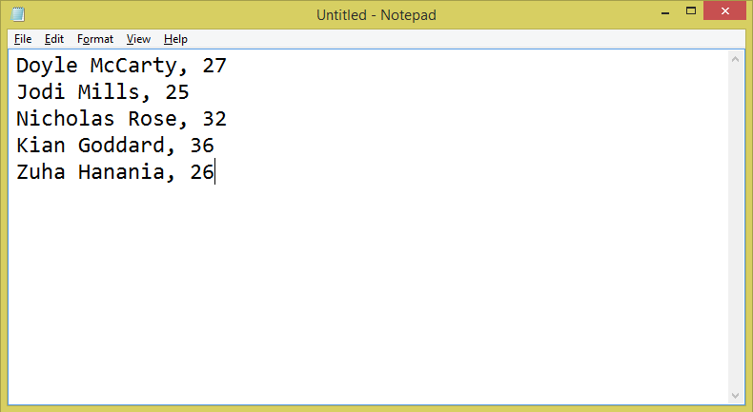
What is a text file?
Text files are just files stored on the file system that contain text data. Most of the time we use Comma Separated Variable (CSV) Files

Slide 7
If you need to store very simple data, text files are a good choice

Slide 8
The great thing about working with text files
Python has built in support for reading and writing from text files
We covered how to do this in “Introduction to Python” Modules 11 & 12
****IS THERE A WAY TO LINK DIRECTLY TO An MVA CHAPTER***
fileName = "GuestList.txt"
accessMode = "w"
myFile = open(fileName, accessMode)
myFile.write("Hi there!\n")
myFile.write("How are you?")
myFile.close()

Slide 9
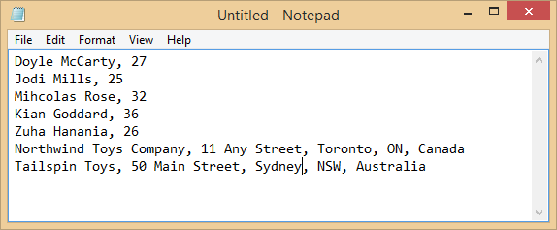
The limitations of text files
Your code has no way of knowing what type of record it is reading from the file

Slide 10
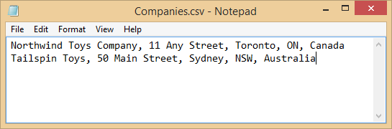
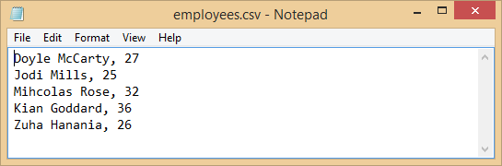
The limitations of text files
If you store data across multiple files, your code has no way of knowing which records go together

Slide 11
The limitations of text files
If you only want one record from the file, you have to read through the file until you find the record you want, so searching or retrieving a single value can be very slow
fileName = "GuestList.txt"
accessMode = "r"
with open(fileName, accessMode) as myCSVFile:
#Read the file contents
dataFromFile = csv.reader(myCSVFile)
#For loop that will run
#once per row
for row in dataFromFile :

Slide 12
Should I use an XML File?

Slide 13
What is an XML file?
XML files are just text files with a very specific structure that includes tags to indicate the data they contain
<?xml version="1.0" encoding="utf-8" ?>
<staff>
<employee id="1">
<name>Doyle McCarty</name>
</employee>
<employee id="2">
<name>Jodi Mills</name>
</employee>
<employee id="3">
<name>Micholas Rose</name>
</employee>
<employee id="4">
<name>Kian Goddard</name>
</employee>
</staff>

Slide 14
XML files are a good choice for storing data that requires more structure
The tags describe the data contained in the file
<?xml version="1.0" encoding="utf-8" ?>
<staff>
<employee id="1">
<name>Doyle McCarty</name>
</employee>
<employee id="2">
<name>Jodi Mills</name>
</employee>
<employee id="3">
<name>Micholas Rose</name>
</employee>
<employee id="4">
<name>Kian Goddard</name>
</employee>
</staff>
1 is the value for the id
Jodi Mills is the value for the name

Slide 15
You can show different record types and their relationships using XML
<?xml version="1.0" encoding="utf-8" ?>
<staff>
<Company>
<name>TailSpin Toys</name>
<employee id="1">
<name>Doyle McCarty</name>
</employee>
<employee id="2">
<name>Jodi Mills</name>
</employee>
</Company>
<Company>
<name>Northwind Toys Company</name>
<employee id="3">
<name>Micholas Rose</name>
</employee>
<employee id="4">
<name>Kian Goddard</name>
</employee>
</Company>
</staff>
These are the employees of TailSpin Toys
These are the employees of Northwind Toys

Slide 16
It is possible to search an XML file or retrieve individual values from the file
Xpath is a syntax for specifying a value in an XML file
Xquery is a syntax for querying an XML file

Slide 17
There are many Python libraries that support working with XML files
Popular libraries include BeautifulSoup and lxml
There is a LOT more to XML than we just discussed!
Be prepared to spend some time learning your way around

Slide 18
Should I use a relational database?

Slide 19
What is a relational database?
A relational database is made up of one or more tables that contain data
Customer Id | Name | City | Country
103 | Bill | Seattle | USA
105 | Satya | Seattle | USA
106 | Susan | Ottawa | Canada
Customer Id | Order Id | Book Title | Price
105 | 96 | Coding with Python | $19.99
106 | 97 | Building Websites | $24.99

Slide 20
It’s called relational because there are relationships between the different tables
The relationships allow us to know how a record in one table is linked to a record in another table
Customer Id | Name | City | Country
103 | Bill | Seattle | USA
105 | Satya | Seattle | USA
106 | Susan | Ottawa | Canada
Customer Id | Order Id | Book Title | Price
105 | 96 | Coding with Python | $19.99
106 | 97 | Building Websites | $24.99

Slide 21
To work with data from a relational database you use Structured Query Language (SQL)
SELECT *
FROM customers
WHERE name=‘Bill Gates’

Slide 22
Relational databases are great because
You can store large amounts of data efficiently
You can keep track of relationships between different records (who ordered what, who works for who, which account belongs to which customer)
You can search for specific records
You can retrieve only the data you need

Slide 23
Relational databases do have overhead
It’s separate software from Python. You have to install the database somewhere it can be accessed by your Python code
Examples of relational databases include SQL Azure, SQL Server, MS Access, MYSQL, and Oracle,

Slide 24
Should I use a NoSQL Database?

Slide 25
What is a NoSQL database?
A database that stores data but not in a series of tables connected through relationships
document databases (e.g. MongoDB)
Graph (OrientDB)
Key-value (e.g. Redis)

Slide 26
Key-Value pair databases are great when you just want to store a series of values
Key | Value
NbrVisitors | 143
Key | Value
User:FirstName | Bill
Key | Value
HighScore | 9000

Slide 27
Redis is a popular Key-value database
To install Redis
Download and execute the Windows setup file
https://github.com/rgl/redis/downloads
Install the redis library in your Python project
In Solution Explorer, expand Python Environments
Right click the Python environment and choose Install Python Package
Type in redis and select OK
Start the redis service
Go to Task Manager| Services
Start the redis service

Slide 28
How do you connect to Redis?
Import the redis library in your code
Create a connection using the StrictRedis function
try:
r=redis.StrictRedis(host='localhost',port=6379,db=0)
return ("Connected")
except:
return ("Could not connect")
Specify the server where your redis database is located, localhost points to the PC or laptop where your code is running
You do not need to change the values for port and db

Slide 29
Installing Redis and checking your Redis installation

Slide 30
What sort of data storage would you choose for the following scenarios?
You are building an online store which sells DVDs and Books. You want the user to be able to see lists of books by author, subject, price, or publication date
You are building a quiz website and you need to store the questions and the correct answers to the questions
You want to keep track of the number of visitors to your website

Slide 31
What have we learned?
You can determine when to use a text file, XML file, relational database, or NoSQL database
You can install and connect to Redis (a NoSQL Database)

Slide 32
What can we do now?
Install Redis on your PC or laptop
Connect to Redis from Python code

